Slide 1
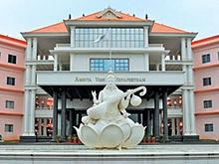

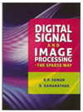
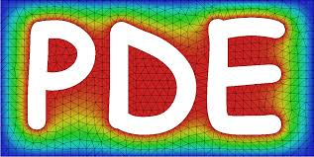
PARTIAL DIFFERENTIAL EQUATIONS (PDE) & IMAGE PROCESSING

Slide 2
2D-Partial Differential Equations
First order derivative
Second order derivative
First order derivative of an image
Second order derivative of an image
Laplacian edge detector

Slide 3
2D- Partial Differential Equations

Slide 4
2D- Partial Differential Equations

Slide 5
2D- Partial Differential Equations
Notes:
Derive d/dx(du/dx)
U(i+2,j)-u(i+1,j)-(u(i+1,j)-u(I,j))

Slide 6
2D- Partial Differential Equations

Slide 7
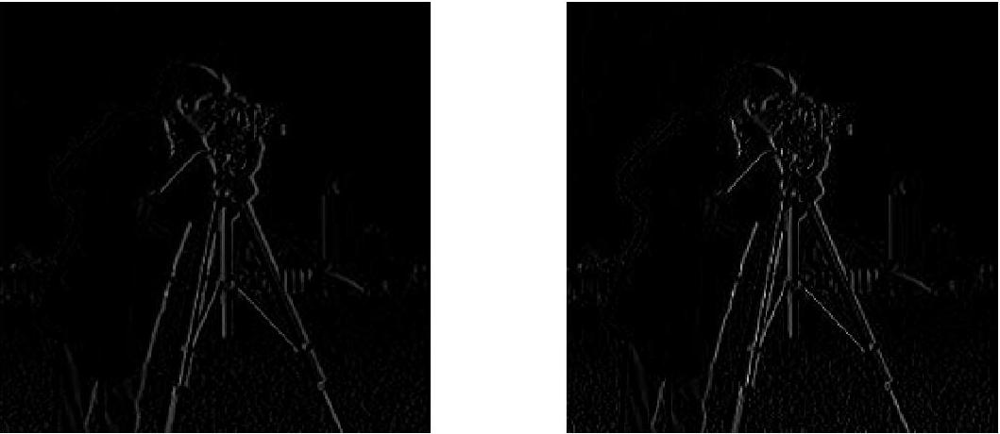
2D- Partial Differential Equations

Slide 8
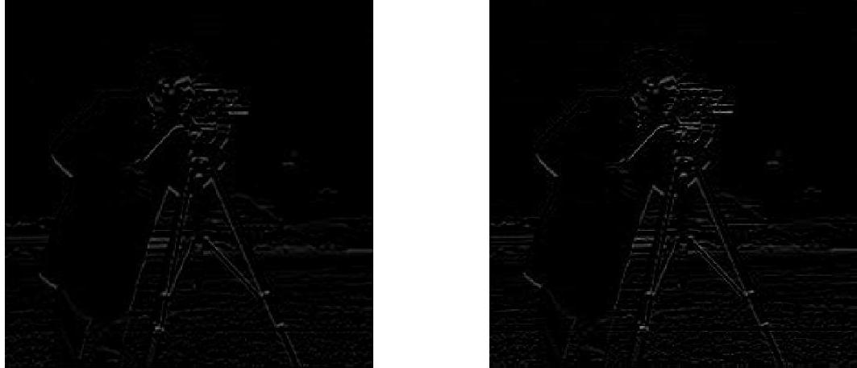
2D- Partial Differential Equations

Slide 9
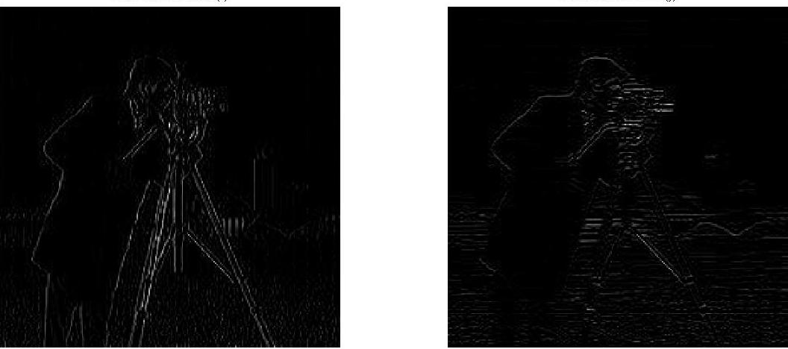
2D- Partial Differential Equations

Slide 10
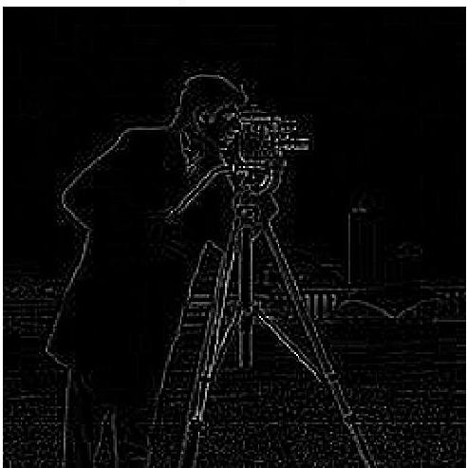
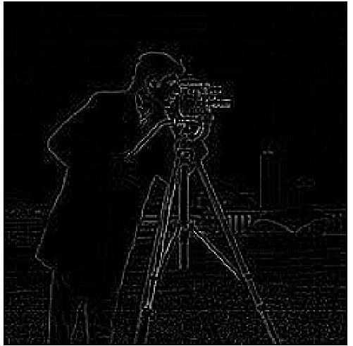
Laplacian Edge Detector
Filter mask

Slide 11
Heat Equation and Image Diffusion

Slide 12
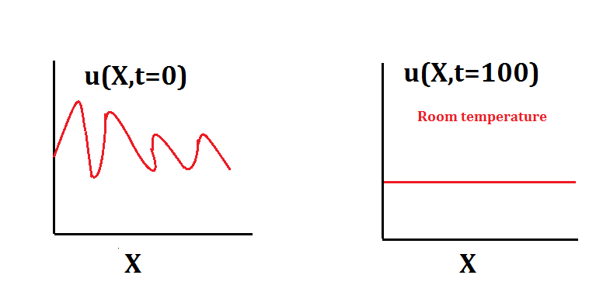
Heat Equation

Slide 13
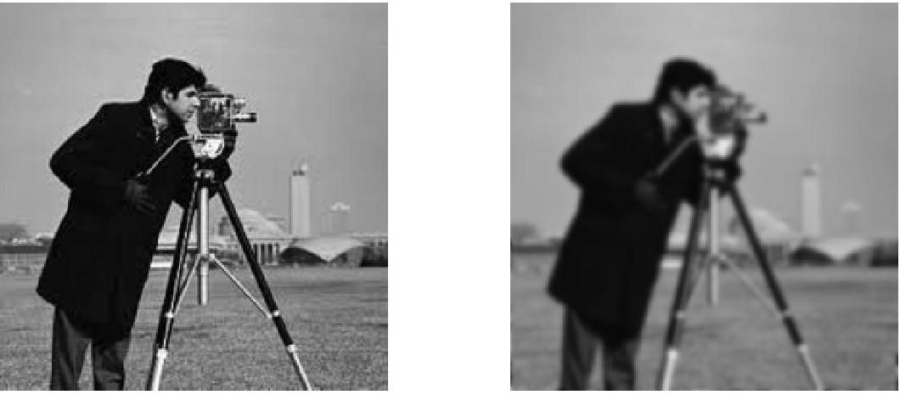
Image Diffusion

Slide 14
Reference
“Digital Signal and Image Processing – The Sparse Way’
– K. P. Soman and
R.Ramanathan

